Slide 1
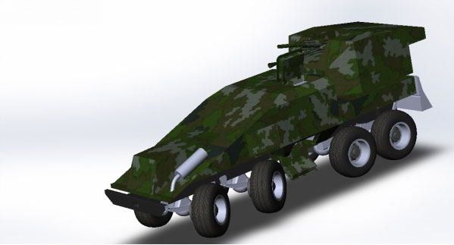


Tactical Vehicle of Fire Support
Patent URL
https://sis.nipo.gov.ua/en/search/detail/842254/

Slide 2
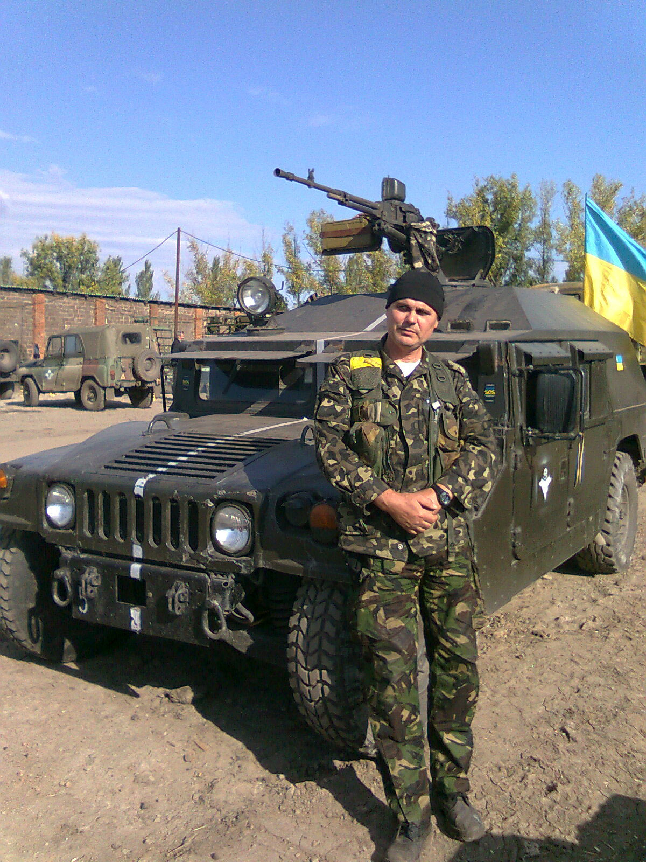
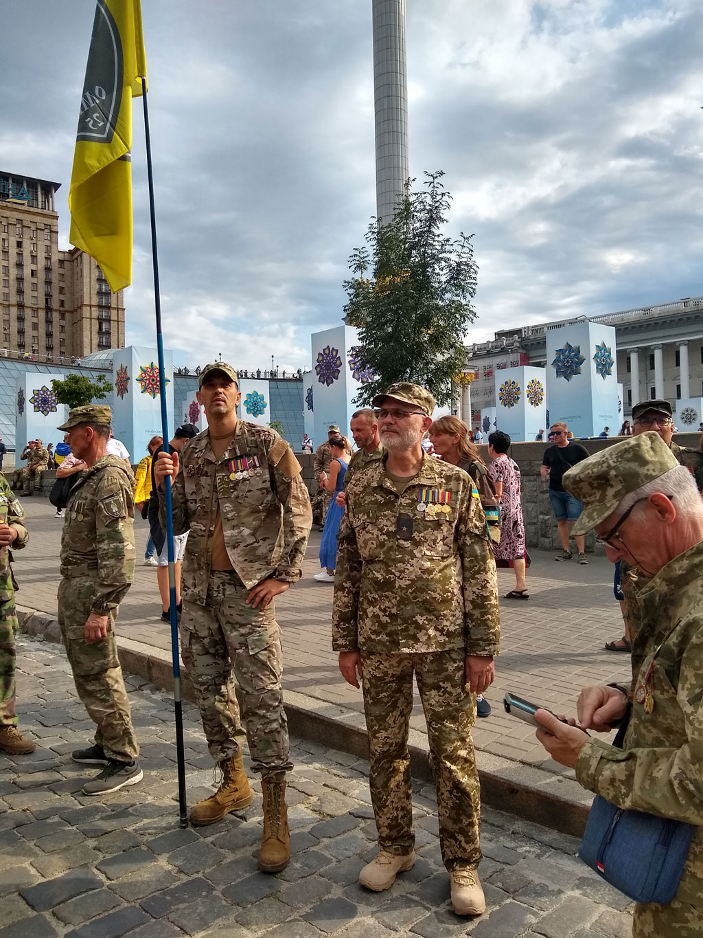
HISTORY OF CREATION
Based on the analysis of ATO obtained during combat experience to ensure a symmetrical response to aforementioned threats and to obtain a decisive advantage over the aggressors in the bar of the tactical confrontation, Ukraine faced an urgent need of adoption something new as a Tactical Vehicle of Fire Support (TVFS).

Slide 3
Purpose of the TVFS
The TVFS is engineered to perform a wide range
of critical combat tasks, including:
Neutralizing enemy anti-tank personnel in urban, field fortifications, and rugged terrains.
Countering mortar, grenade launcher, and sniper attacks, as well as enemy ambushes.
Engaging lightly armored targets, clusters of vehicles, and field fortifications.
Combatting single tanks, combat vehicles, helicopters, and UAVs.
Conducting reconnaissance and deep raids into enemy territory.
Supporting and protecting troop convoys on the frontline.

Slide 4
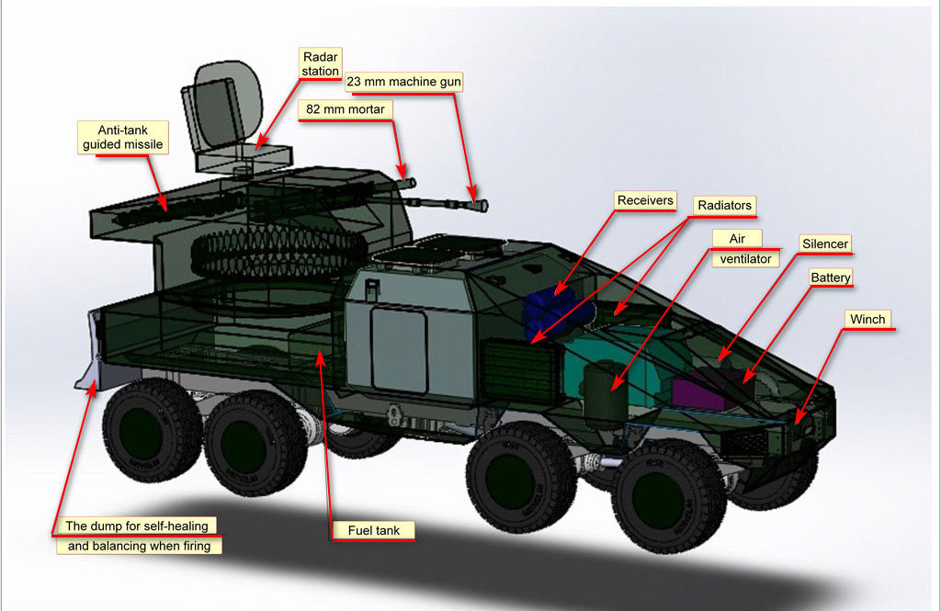
Design Features
The TVFS is based on a modular and robust design to maximize adaptability, firepower, and crew protection.

Slide 5
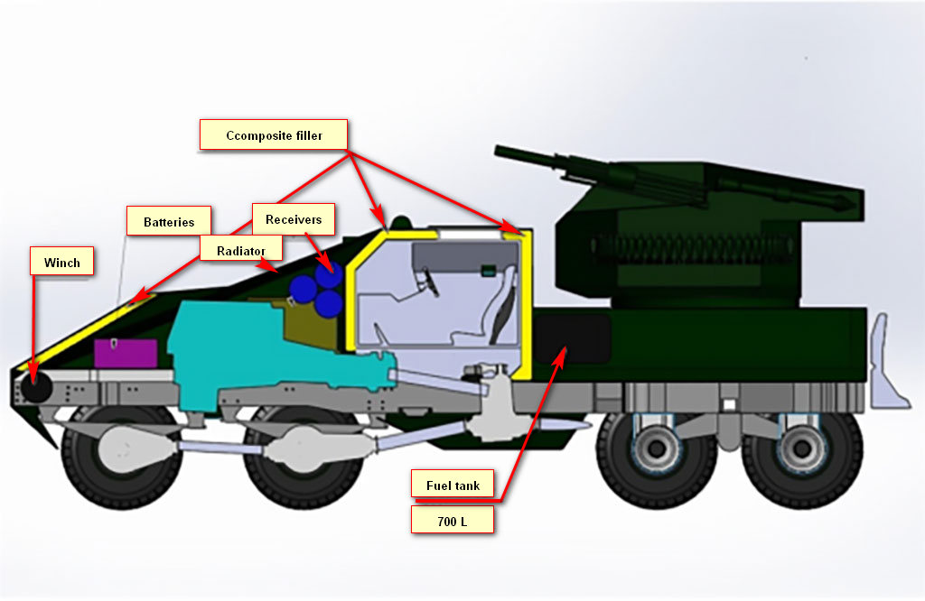
Design Features
The TVFS is based on a modular and robust design to maximize adaptability, firepower, and crew protection.

Slide 6
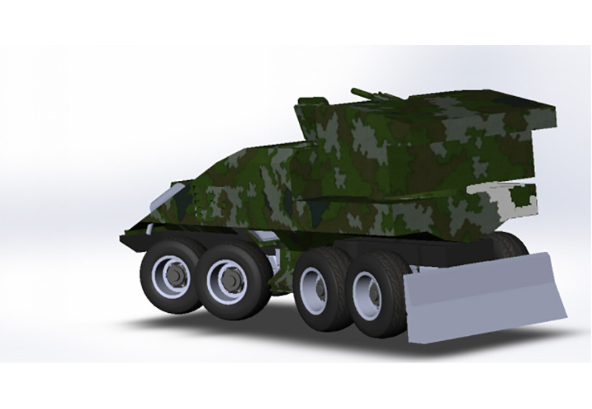
Chassis and Mobility
Four-axis wheeled chassis:
Bullet-resistant wheels ensure adaptability to various terrains and high survivability.
Chassis options:
Initial designs use a KrAF 8×8 platform with a Cummins 400 hp turbo-diesel engine and automatic transmission.
Maximum speed:
90 km/h on highways; range up to 700 km.

Slide 7
Armament
The TVFS offers an unmatched arsenal for tactical engagements:
82mm Automatic Mortar:
Type: 2B9 “Cornflower” with modified auto-loading.
Rate of fire: Up to 100 rounds/min.
Effective range: 4,200–5,000 meters.
Special features: Barrage capabilities to neutralize enemy ambushes in wooded or camouflaged areas.
23mm High-Speed Automatic Cannon:
Effective range: Up to 3,500 meters.
Ammunition: 600 shells.
Features: Dual-axis stabilization for precision firing on the move.

Slide 8
Armament
The TVFS offers an unmatched arsenal for tactical engagements:
ATGM System:
Types: “Stugna” or “Skif.”
Guidance: Four missiles with advanced targeting systems.
Range: Up to 5,500 meters with pinpoint accuracy.
Automated Targeting System:
Integrates with fire control for rapid identification and engagement.

Slide 9
Crew Safety and Armored Protection
Armored Capsule:
Houses the three-member crew: commander, driver-mechanic, and gunner-operator.
Enhanced protection with a 100mm corundum-filled gap between the capsule and main armor to dissipate kinetic energy and cumulative charges.
Ballistic Protection:
Safeguards against small arms fire and shrapnel.
Self-digging capabilities:
Enhances stability during firing and provides self-recovery options.

Slide 10
Advantages
The TVFS provides unparalleled firepower and survivability on the battlefield. Key features include:
Large ammunition capacity for prolonged engagements.
Automated weapons systems: Reduces crew exposure and enhances operational efficiency.
Modular platform: Allows for future upgrades and integration of foreign weapon systems, expanding export potential.

Slide 11
Technical Specifications
Maximum weight: 25,000 kg
Crew: 3 (commander, driver, gunner)
Engine: 400 hp diesel
Transmission: Automatic
Speed: 90 km/h
Range: 700 km
Armament: 82mm mortar, 23mm cannon, ATGM system
Fire Control System: Automated targeting

Slide 12
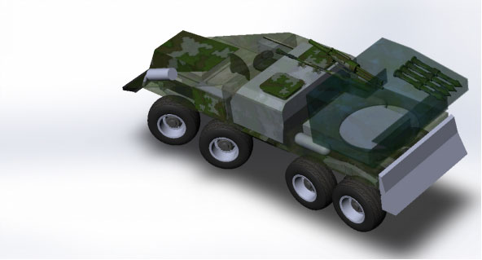
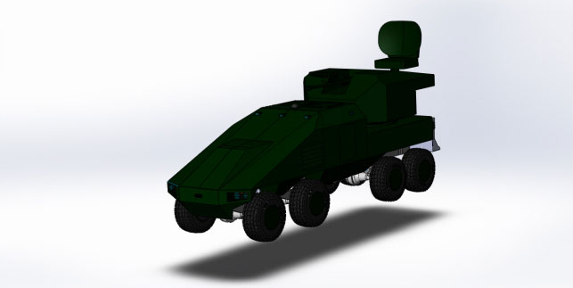
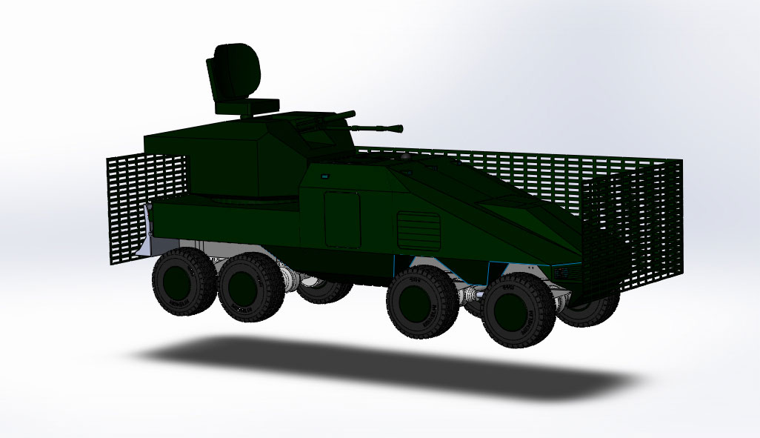
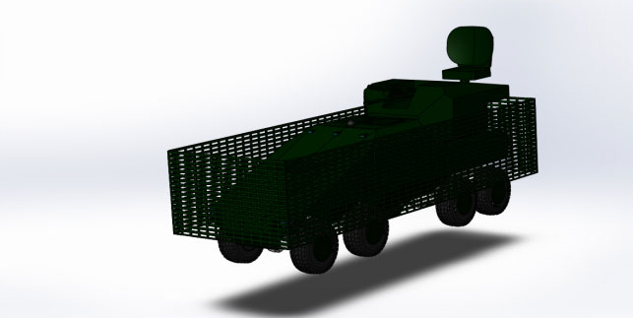
General view of Tactical Vehicle of Fire Support

Slide 13


The Tactical Vehicle of Fire Support represents a groundbreaking advancement in military technology for Ukraine. Its innovative design, modular construction, and superior firepower make it an essential asset for ensuring tactical superiority in modern warfare.
Conclusion
Contact person: YURIY DONCHENKO
tel: +38(096)554-8341
URADONKO3@gmail.com
www.donkolab.com
Copyright © 2024, Yuriy Donchenko. All Rights Reserved.

